Slide 1
Software Quality Assurance and Testing Technology
2nd Semester, Spring 2022
Xiaoping CHE (xpche@bjtu.edu.cn)
Associate Professor
School of Software Engineering
Beijing Jiaotong University

Slide 2
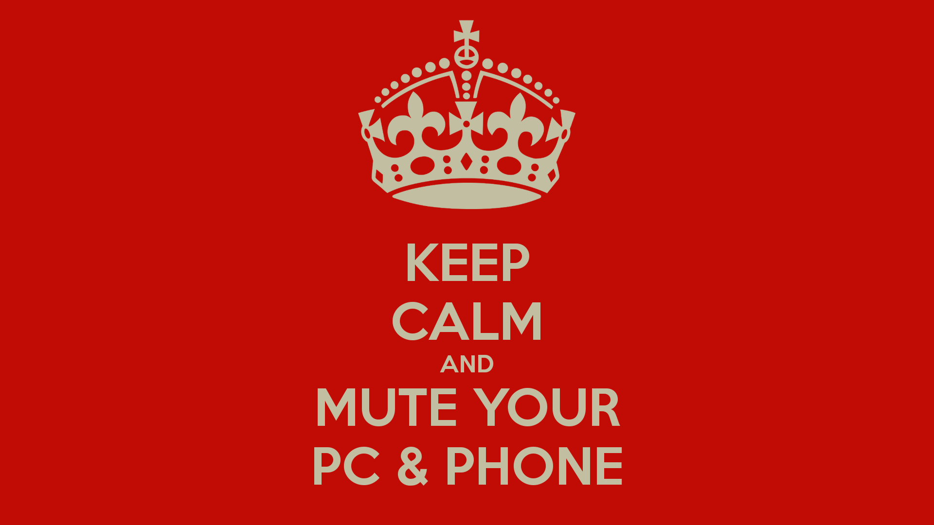
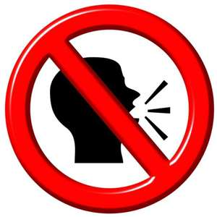
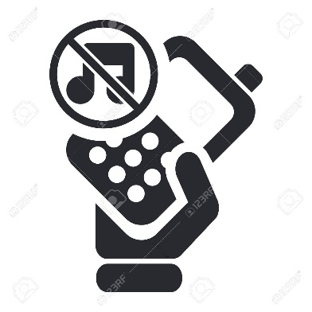


Rules

Slide 3
Rules
Project 20%
Assignments 40%
Final Exam 40%

Slide 4
How
16 Weeks Plan
Week 1: The basic concepts and theories of testing
Week 2-3: Principles of Testing
Week 4-5: Test Cases & Black Box Testing
Week 6-9: White Box Testing
Week 10-11: Integration Testing
Week 12： Usability Testing and System Testing

Slide 5

How
References
Ron Patton, Software Testing (2th Edition)
Glenford J. Myers, The Art of Software Testing (3rd Edition)
Gerald M. Weinberg, Perfect Software

Slide 6
Review

Slide 7
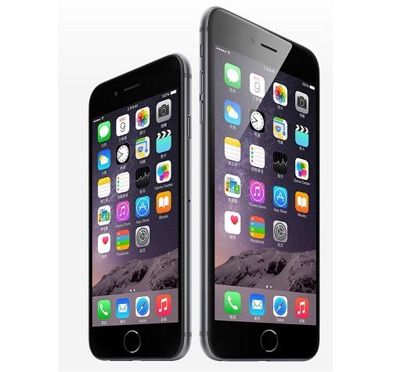
System Testing
Important traits of a good UI
Follows standards and guidelines
Intuitive
Consistent
Flexible
Comfortable
Correct
Useful

Slide 8
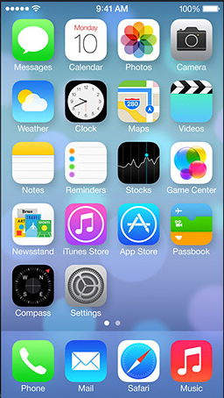
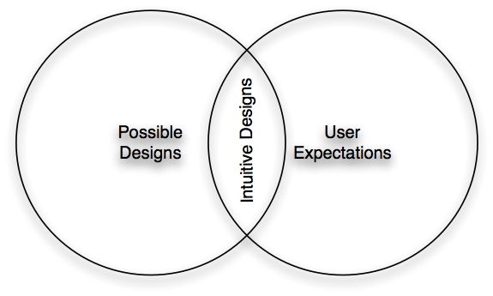
System Testing
Intuitive UI

Slide 9
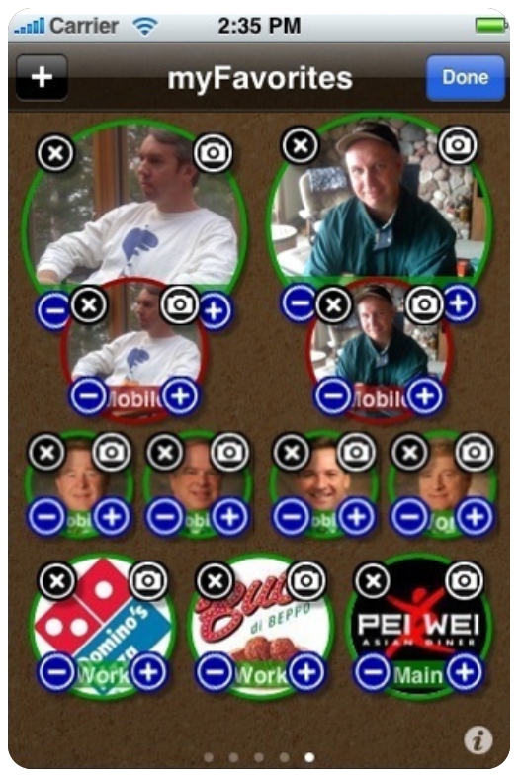
System Testing
Intuitive UI ？

Slide 10
System Testing
Consistent UI
Shortcut keys and menu selections
F1 should always get you Help in MS Windows.
Different UI paths should have the same F key to execute a feature.
Terminology and naming
Is Find sometimes called Search?
Audience
Consider the success of the UI of the car and ATM.
Placement of buttons such as OK and Cancel
In Mac OS, the OK button is always on the right.
In MS Windows the, the OK button is on the left and Cancel is on the right.

Slide 11
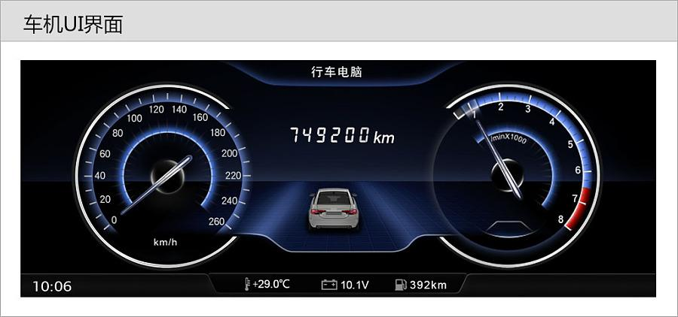
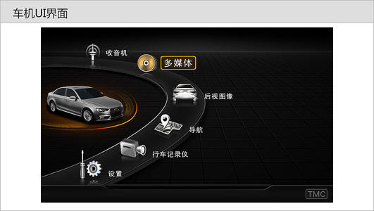
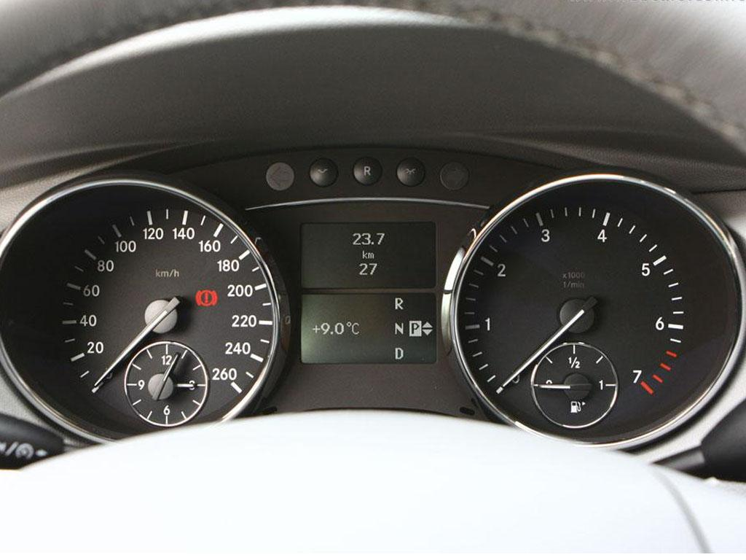
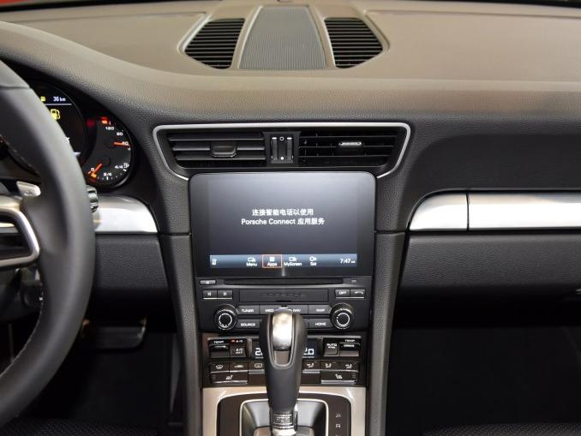
System Testing
Consistent UI

Slide 12
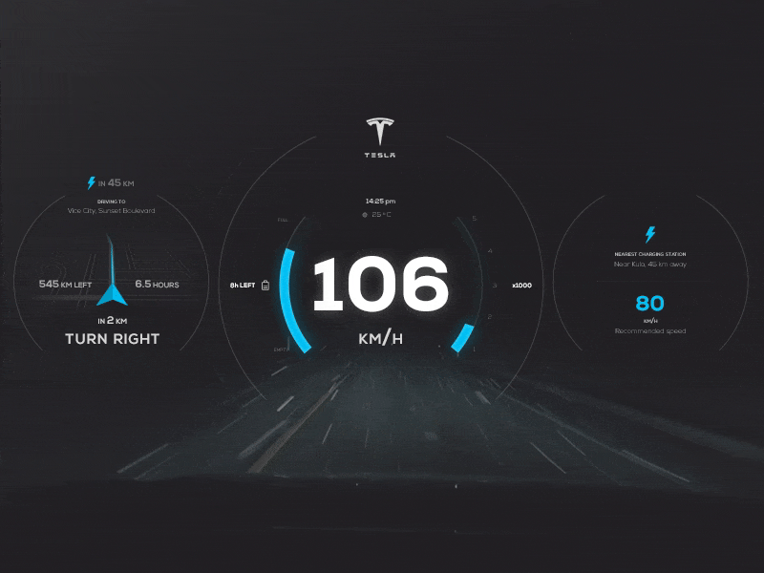
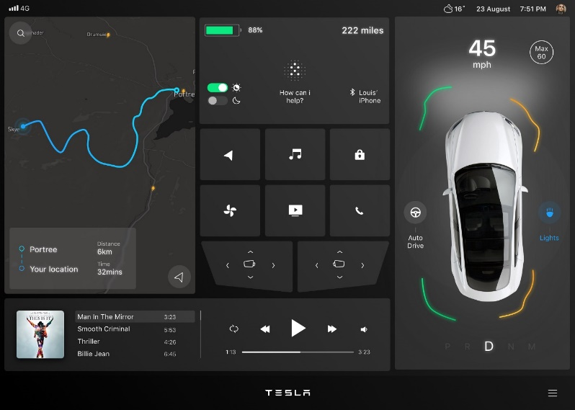
System Testing
Consistent UI

Slide 13
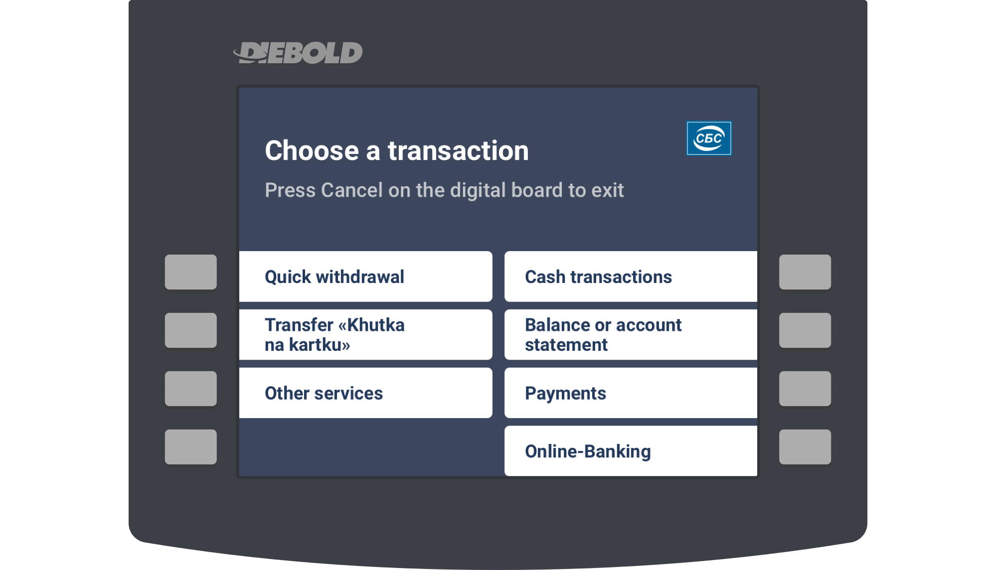
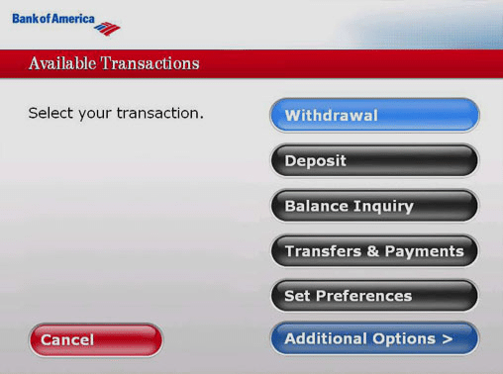
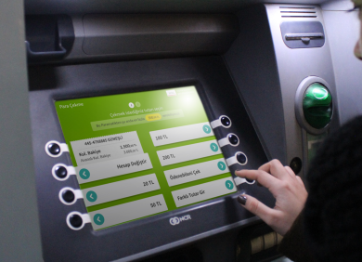
System Testing
Consistent UI

Slide 14
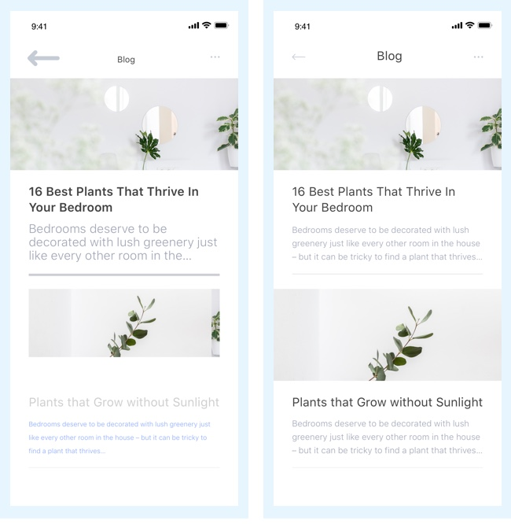
System Testing
Consistent UI

Slide 15
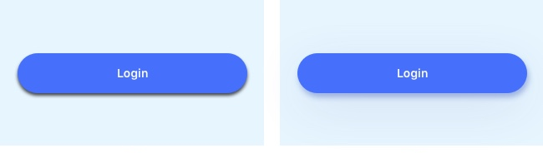
System Testing
Consistent UI

Slide 16
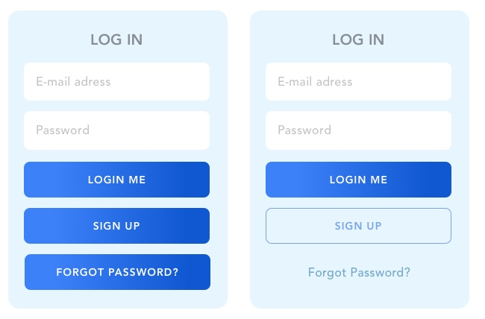
System Testing
Consistent UI

Slide 17
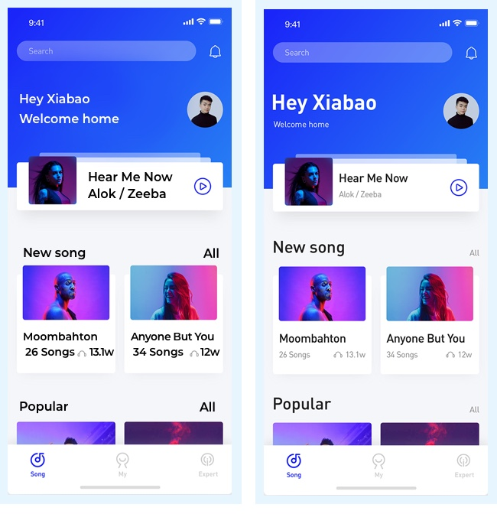
System Testing
Consistent UI

Slide 18
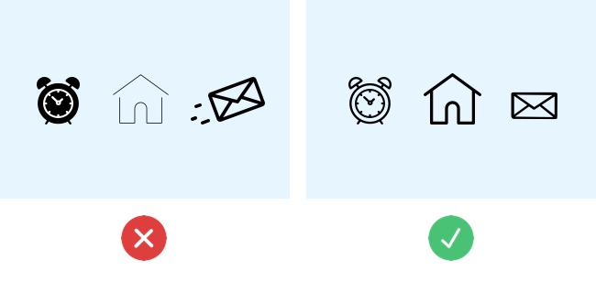
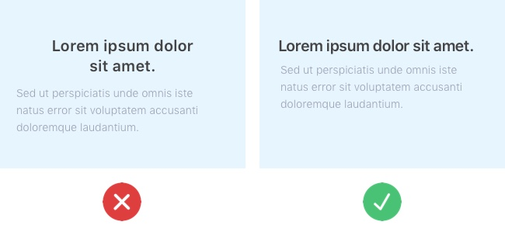
System Testing
Consistent UI

Slide 19
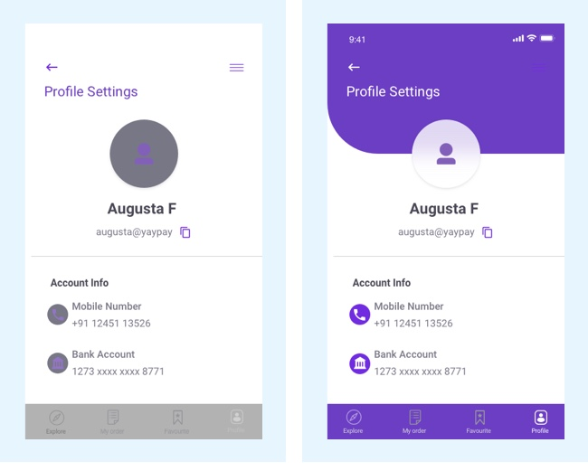
System Testing
Consistent UI

Slide 20
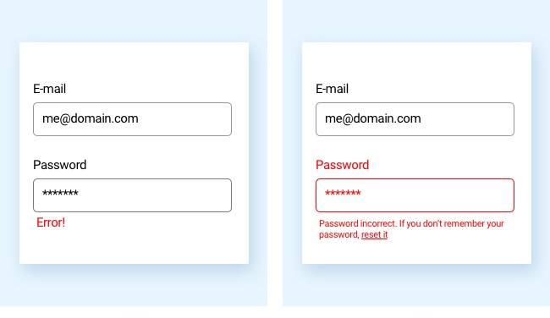
System Testing
Consistent UI

Slide 21
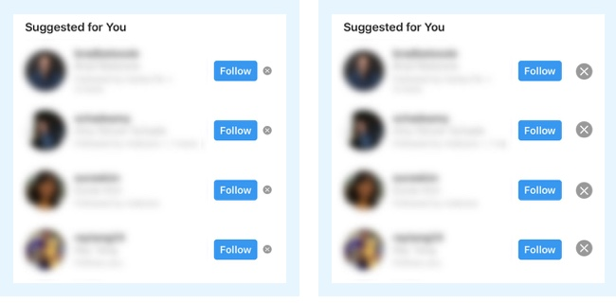
System Testing
Consistent UI

Slide 22
System Testing
Consistent UI

Slide 23
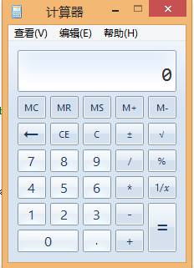
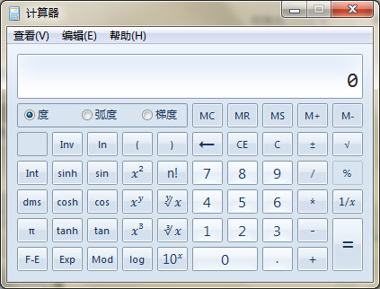
System Testing
Flexible UI
Users like choices … but not too many.
E.g., MS simple and scientific calculators
Flexible UIs provide:
State jumping
Many alternative ways to achieve the same goal.
State termination and skipping
“If you know your party’s extension enter it at any time”.
Multiple ways to perform I/O
Excel allows many input formats (from keyboard or files) and many output formats (table, graphs, charts).

Slide 24
System Testing
Comfortable UI
Sounds like a strange notion …
Is the UI appropriate?
Sound effects in a computer game? How about a business application?
Does the UI handle errors well?
If there is no Undo/Redo feature critical operations may fail.
Is the feedback fast enough or too fast?
E.g., waiting for cash to come out of the ATM
Does excessive use cause harm?
E.g., Emacs hand

Slide 25
System Testing
Correct UI
Marketing differences
Are there extra or missing functions from what the marketing material states?
Language and spelling
Error messages often have spelling mistakes
Bad media (icons, images, sounds, videos) that for with the software UI.
WYSIWYG
E.g., does the printed Adobe Acrobat file look like the one on the screen?

Slide 26
System Testing
Useful UI
When testing a UI feature, ask if the feature you see actually contributes to the software’s value.
Many applets have useless features
E.g., dancing elves
Useless UI features waste time for the user, developer, and tester.

Slide 27
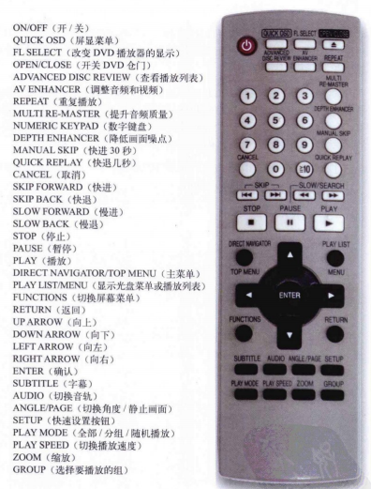
Useful UI

Slide 28
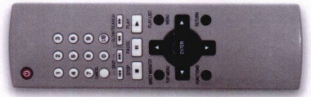
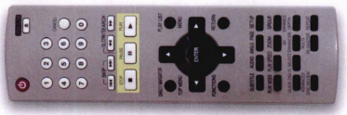
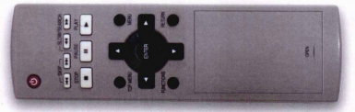
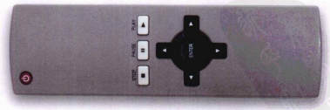
Useful UI

Slide 29
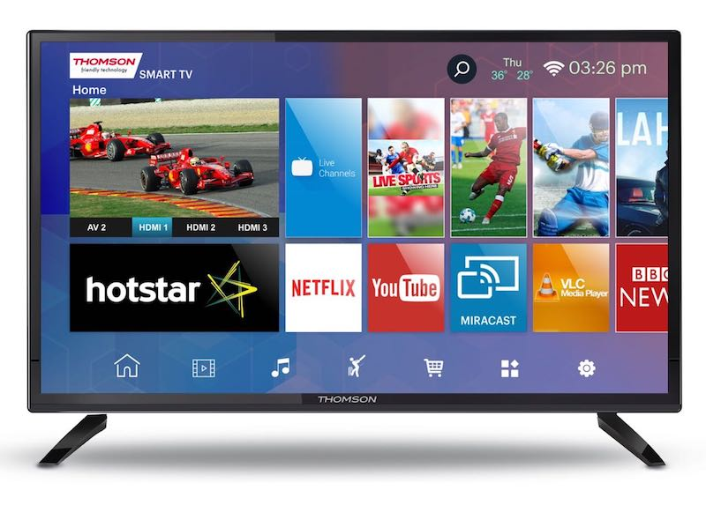
Useful UI

Slide 30


Useful UI

Slide 31
System Testing
Accessibility Testing (testing for the disabled)
Nearly 20% of American have some form of disability according to the 1997 US Census.
The following impairments make using computers especially difficult:
Visual
E.g., color blindness, tunnel vision, cataracts.
Hearing
E.g., partial or complete deafness.
Motion
E.g., injury can make using a keyboard or mouse difficult or impossible.
Cognitive and language
E.g., dyslexia or memory problems and using complex UIs

Slide 32
System Testing
Legal requirements
In the US, three laws apply to developing software with a UI that can be used by the disabled:
The Americans with Disability Act (ADA) has been applied to commercial Internet websites.
Section 508 of the Rehabilitation Act is similar to the ADA and applies to any organization that receives federal funding.
Section 255 of the Telecommunications Act requires all hardware and software that transfers information over the Internet/network/phone line be accessible to people with disabilities.

Slide 33
System Testing
Accessibility features in software
If the software being tested does not run on a platform that has specified accessibility features?
Accessibility features will have to be specified, programmed, and tested.
If your platform has built in accessibility features your software?
Software only needs to adhere to the platform’s standard for communicating with peripheral devices.
Remember to create test cases specifically to test for accessibility.
Add them to your configuration testing equivalence partitions.

Slide 34
System Testing
Microsoft Windows accessibility features
Sticky-keys: Allow Shift, Ctrl, Alt keys to stay in effect until the next key is pressed.
Filter-keys: prevents brief repeated keystrokes from being recognized.
Toggle-keys: plays tomes when Caps Lock, Scroll Lock, or Num Lock keyboard modes are enabled.
Sound-sentry: creates a visual warning whenever the system generates a sound.
Show-sounds: instructs program to display captions for any sounds or speech they make.

Slide 35
System Testing
Microsoft Windows accessibility features (cont’d)
High contrast: sets up the screen with colors and fonts designed to be read by the visually impaired.
Mouse-keys: allows the use of keyboard keys instead of he mouse to navigate.
Serial-keys: sets up a communication port to read in key strokes from an external (non-keyboard) device.

Slide 36
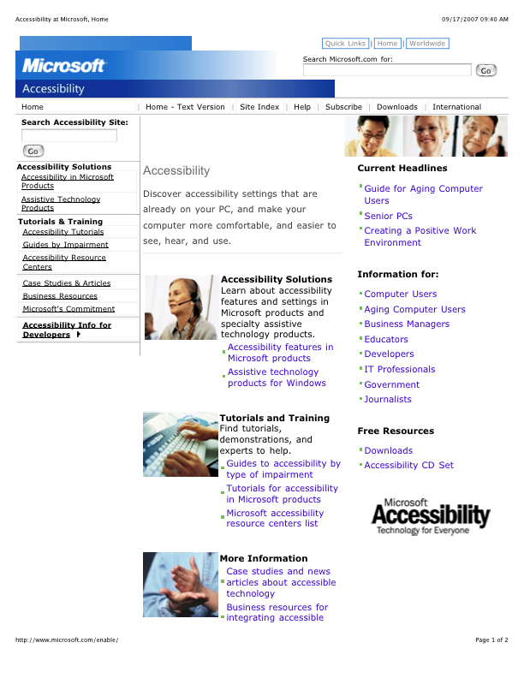
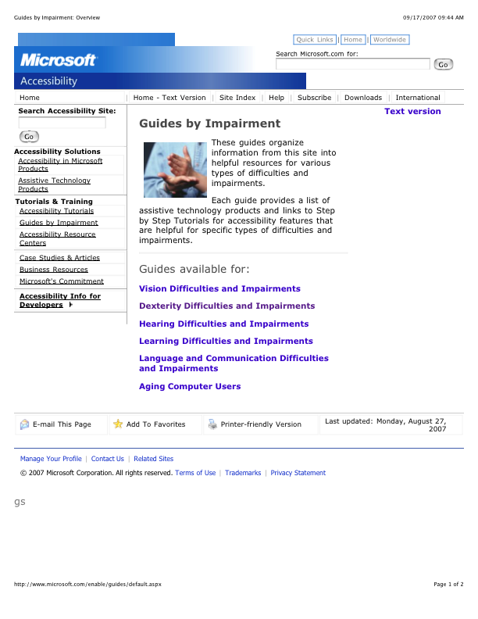
System Testing
Microsoft’s accessibility website

Slide 37
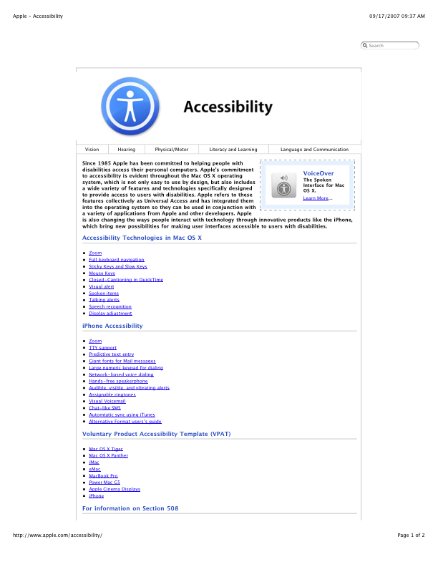
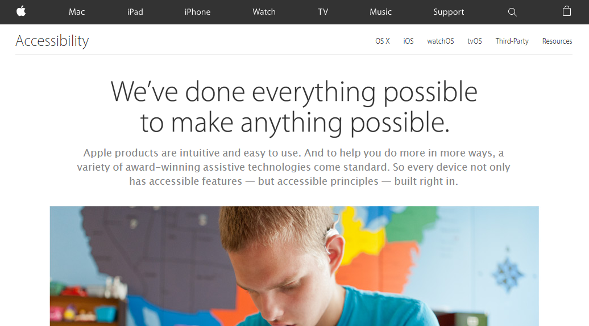
System Testing
Apple’s accessibility website

Slide 38
To be continued… See you next week

